Slide 1
Greedy Algorithms and Recursive Exhaustive Search

Slide 2

Trick Or Treating
You have amassed a pile of N pieces of candy,
where candy piece j has a weight of w_{j}.
You would like to transport as many pieces of candy as possible, but you have a bag that can only hold 10 pounds of candy.

Slide 3
Trick Or Treating
You have amassed a pile of N pieces of candy, where candy piece j has a weight of w_{j}.
You would like to transport as many pieces of candy as possible, but you have a bag that can only hold 10 pounds of candy.
Optimal Solution: Add candy to the bag in sorted order by weight (lightest first).

Slide 4
Trick Or Treating II
You have amassed a pile of N pieces of candy,
where candy piece j has a weight of w_{j}.
Suppose candy piece j has a yumminess y_{j}.
You would like to transport a subset of candy having maximum yumminess, but you have a bag that can only hold 10 pounds of candy.

Slide 5
Trick Or Treating II
You have amassed a pile of N pieces of candy, where candy piece j has a weight of w_{j}.
Suppose candy piece j has a yumminess y_{j}.
You would like to transport a subset of candy having maximum yumminess, but you have a bag that can only hold 10 pounds of candy.
Reasonable solution (but not necessarily optimal): add candy to bag in decreasing order of y_{j} / w_{j}.
(the problem above is known as the “knapsack problem”, and is actually NP-hard!)

Slide 6
Greedy Algorithms
Greedy algorithms typically build a solution step by step, where in each step they make the best possible “greedy” short-term decision.
Often implemented by just sorting the input elements in
some appropriate way (e.g., lightest to heaviest).
Decisions usually not reconsidered.
Greedy algorithms usually very fast and simple.
For many problems, they may not give an optimal solution, but they often do reasonably well.
Justifying whether they give an optimal or near-optimal solution is often the tricky part…

Slide 7
Class Scheduling
You have N classes available to take.
Class j meets during the time interval [a_{j}, b_{j}].
You want to take as many classes as possible, but you can’t take two classes if they overlap.
What are some reasonable greedy approaches
here?

Slide 8
Class Scheduling
You have N classes available to take.
Class j meets during the time interval [a_{j}, b_{j}].
You want to take as many classes as possible, but you can’t take two classes if they overlap.
What are some reasonable greedy approaches here?
Optimal solution: schedule class C that ends
earliest, remove classes conflicting with C, repeat.

Slide 9
Class Scheduling
You have N classes available to take.
Class j meets during the time interval [a_{j}, b_{j}].
You want to take as many classes as possible, but you can’t take two classes if they overlap.
What are some reasonable greedy approaches
here?
Optimal solution: schedule class C that ends earliest, remove classes conflicting with C, repeat.
– Why is this optimal? I.e., why is it “safe” to assume that
an optimal schedule includes the class C?

Slide 10
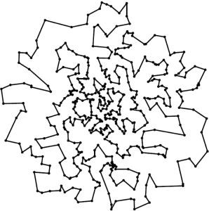
Traveling Salesman
Goal: connect N cities (here, in the 2D plane) with
a minimum-length tour.
NP-hard problem, so getting optimal solution not computationally feasible for large N.
What would a greedy algorithm
for TSP look like?

Slide 11
Traveling Salesman : Greedy
Start somewhere.
Move to the nearest yet-unvisited point.
Repeat.

Slide 12
Traveling Salesman : Greedy
Start somewhere.
Move to the nearest yet-unvisited point.
Repeat.
Is this likely to generate a good solution? If not, how can you make it better?

Slide 13
Traveling Salesman : Greedy
Start somewhere.
Move to the nearest yet-unvisited point.
Repeat.
Is this likely to generate a good solution? If not, how can you make it better?
Use as starting point for iterative refinement
“Backtrack” and search other tours…

Slide 14
Traveling Salesman : Recursive
Exhaustive Search
Start somewhere.
Loop through all possible points as the second point in the tour.
For each of these, recursively loop through all possible points as the third point.
Etc.
Running time?

Slide 15
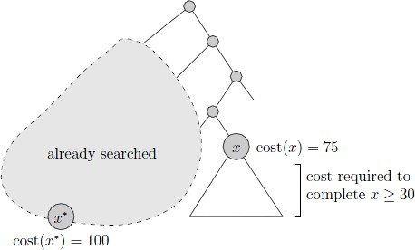
Traveling Salesman : Pruned Recursive Exhaustive Search
Do the recursive search just as before.
Keep track of best solution found so far (called the “incumbent” solution.
If we ever build a partial solution that has no hope of being extended to a full solution better than the incumbent solution, “prune” search
(i.e., back up and try other possibilities)
(Sometimes relevant, but not so much TSP)… if we ever build an infeasible solution, prune search as well.

Slide 16
Traveling Salesman : Pruned Recursive Exhaustive Search
Do the recursive search just as before. Keep track of best solution found so far (called the “incumbent” solution. If we ever build a partial solution that has no hope of being extended to a full solution better than the
incumbent solution, “prune” search (i.e., back up and try other possibilities) (Sometimes relevant, but not | Known as “Branch and Bound”
so much TSP)… if we ever build an infeasible solution, prune search as well.

